Slide 1
Data collection and research ethics
Class 4
EDUC 157: Educational Research and Evaluation
UCI School of Education

Slide 2
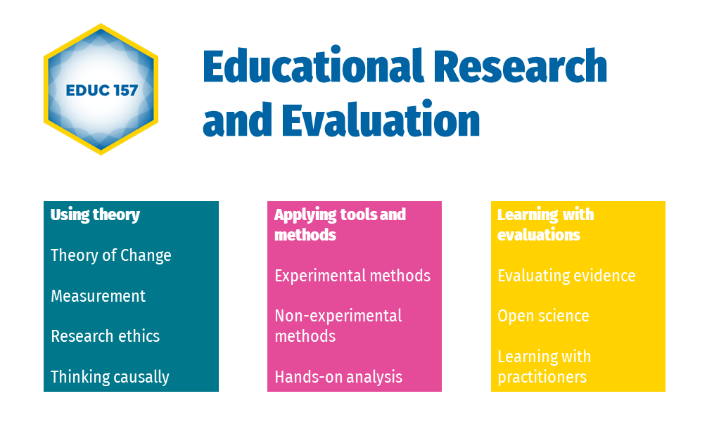

Slide 3


As New York City unveils a 485-million-dollar plan to reduce shootings, some experts are questioning how officials will measure whether it’s working. (…)
Former director of the Mayor’s Office of Criminal Justice Liz Glazer says (…) its success will depend on the execution. “Who is tasked with waking up with a stomachache every morning thinking only about this?” The report includes a long list of metrics to gauge whether the city’s anti-gun violence plan seems to be working. Those start with more obvious data points like the number of people shot and the rate of assault hospitalizations. But the officials would also like to see drops in school absenteeism, shorter waitlists for housing when people are released from jail, and more trees planted along the city’s streets.

Slide 4
Inputs
“USD485m”
“Who is tasked”
?
Indicators & Data
?
Activities
?
Indicators & Data
?
Trees planted by program
?
Indicators & Data
No. of trees planted by the program
Outputs
?
?
Intermediate outcomes
Green neighborhoods
School absenteeism
Re-integration after jail
Indicators & Data
No. of trees across neighborhoods
Length of housing waitlist
?
Gun violence / shootings
Indicators & Data
No. of people shot
Rate of assault hospitalizations
Final outcomes

Slide 5

“Implementation and success will be tracked by both short-term process metrics and longer-term outcome indicators. Performance management will be conducted through 1) Citywide and neighborhood-level metrics directly related to gun violence and key indicators for upstream determinants of gun violence, 2) Key Performance Indicators for each strategy [out of 7 strategies], and
3) implementation indicators for every action and initiative.”

Slide 6
“Implementation and success will be tracked by both short-term process metrics and longer-term outcome indicators. Performance management will be conducted through 1) Citywide and neighborhood-level metrics directly related to gun violence and key indicators for upstream determinants of gun violence, 2) Key Performance Indicators for each strategy [out of 7 strategies], and
3) implementation indicators for every action and initiative.”
Final outcomes
Intermediate outcomes
Outputs
Outputs & Activities

Slide 7
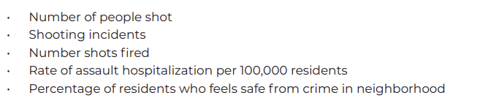
Final outcomes

Slide 8
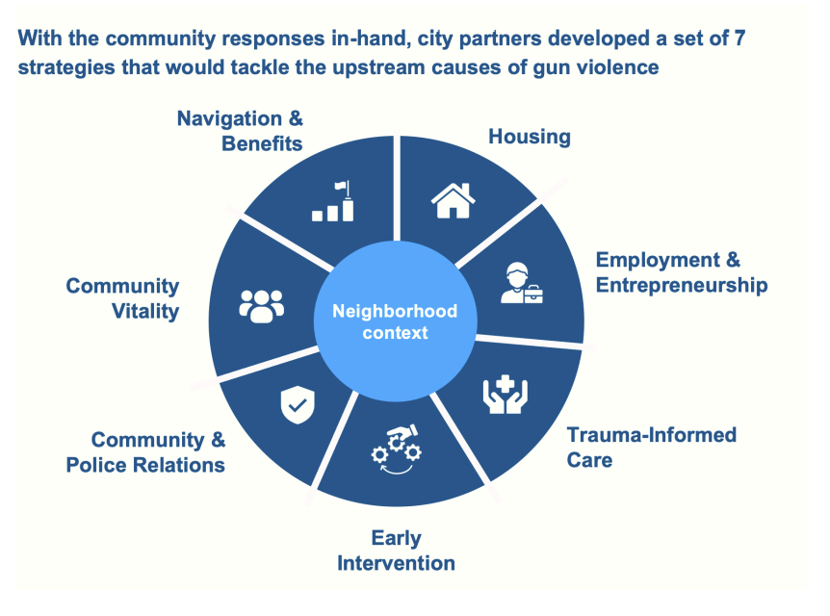
Intermediate outcomes

Slide 9
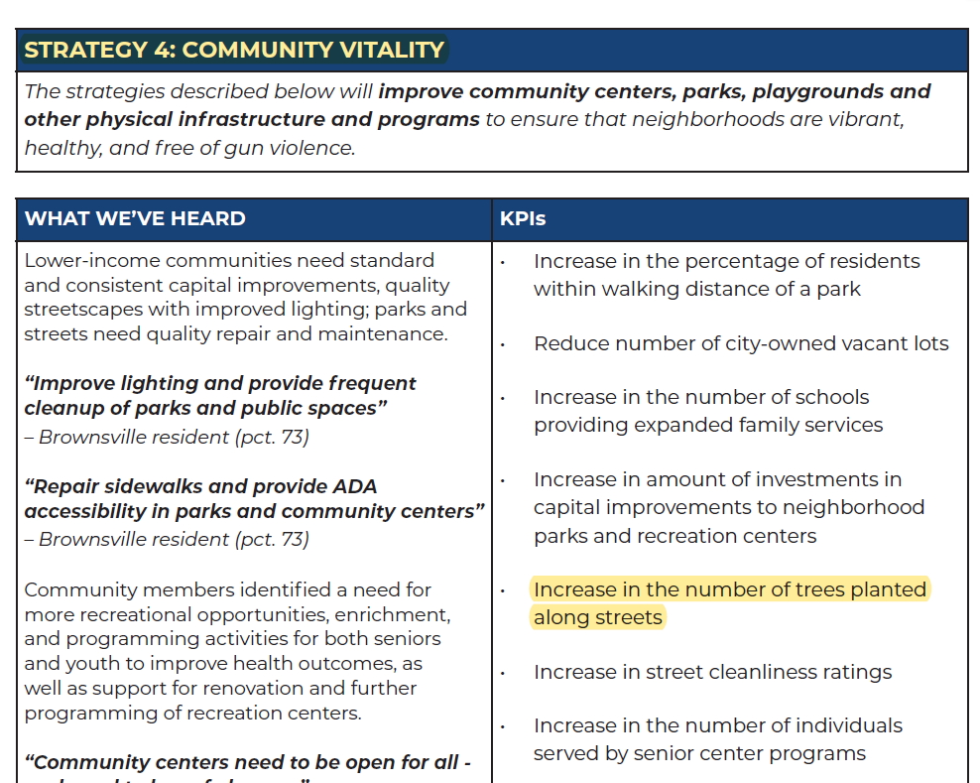
Intermediate outcomes
Outputs

Slide 10

As New York City unveils a 485-million-dollar plan to reduce shootings, officials have also presented a plan to measure whether it’s working.
The Mayor’s initiative will measure its success with gun-violence-related indicators, including the number of people shot and the rate of assault hospitalizations.
The initiative’s wide range of activities aims to address seven determinants of gun violence. One of these seven determinants is a community’s lack of “vitality,” and the initiative includes efforts to make neighborhoods more vibrant, healthier, and greener.

Slide 11
Plan for today
Managing data collection
Ethical research principles
Permits and approvals

Slide 12
Managing data collection

Slide 13
Construct
The main concept under empirical investigation. A concept is usually abstract and requires “conceptualization.” Once better defined, more specific, and measurable, we call it a “construct.”
(E.g., foundational literacy).
Theory
Indicators
An observable signal used to measure constructs.
(E.g., whether a child can read a word, whether a child can read a short sentence such as “this is a dog”).
Instrument
The tools we use to measure indicators (e.g., classroom observations, teacher interviews, or student assessments).
Data collection
Data
The numeric values of indicators (“variables”) for the person or group of people we interview, test, or observe (“respondents”, “subjects”).

Slide 14
Primary data
Secondary data
Surveys
Admin. data
Focus groups
Sensor data
Observations
Web traffic, click-stream, phone
Games
Existing research data
Diaries
Maps
Assessments
Text, audio, video

Slide 15

Primary data

Slide 16
Plan
Design, pilot
Collect data
Manage data

Slide 17
Plan
Design, pilot
Collect data
Manage data
Budget
Schedule
CAPI vs PAPI
(Out)source
Permits

Slide 18
Plan
Design, pilot
Collect data
Manage data
Budget
Draft, program
Schedule
Pilot
CAPI vs PAPI
Translate
(Out)source
Repeat
Permits

Slide 19
Plan
Design, pilot
Collect data
Manage data
Budget
Draft, program
Recruit
Schedule
Pilot
Train
CAPI vs PAPI
Translate
Assess
(Out)source
Repeat
Manage
Permits
Involve partners

Slide 20
Plan
Design, pilot
Collect data
Manage data
Budget
Draft, program
Recruit
Quality control
Schedule
Pilot
Train
Data entry
CAPI vs PAPI
Translate
Assess
Data flow
(Out)source
Repeat
Manage
Security
Involve partners
Publication
Permits

Slide 21
Plan
Design, pilot
Collect data
Manage data
Budget
Draft, program
Recruit
Quality control
Schedule
Pilot
Train
Data entry
CAPI vs PAPI
Translate
Assess
Data flow
(Out)source
Repeat
Manage
Security
Involve partners
Publication
Permits

Slide 22
Ethical principles

Slide 23
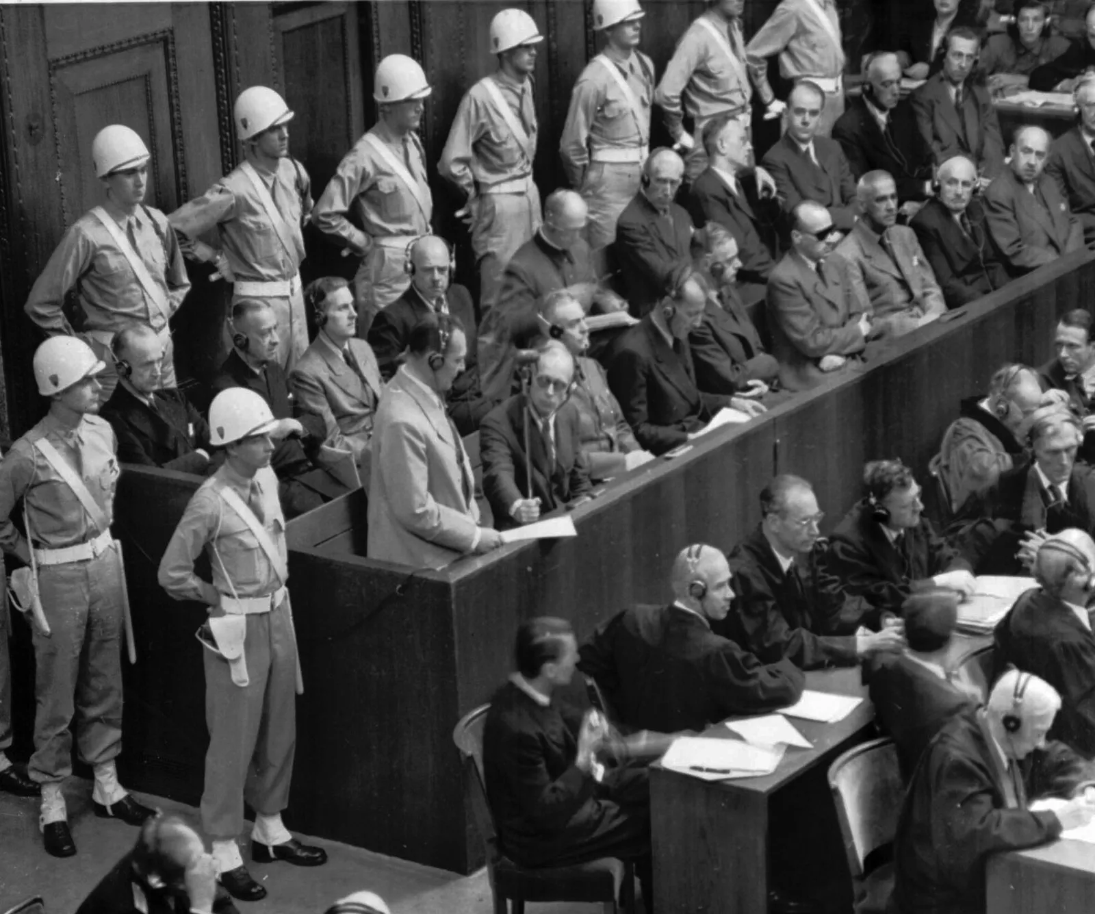
Origins of today’s ethical standards
Nazi experimentation
→ Nuremberg Trials (1945-46)
→ Nuremberg Code (1947)
→ Declaration of Helsinki (1964)
Public Health Service’s Tuskegee Syphilis Study (1932-72)
→ National Research Act
→ The Belmont Report (1978)
AP Images
Notes:
As you are likely familiar, in the 1930s and early 40s, Nazis conducted egregious human experimentation on unwilling subjects, the details of which were discussed in the Nuremberg trials of 1945-46. In response, the research community developed the nuremberg code, which was one of the first major documents on research ethics. It’s first major principle: voluntary consent of participants
Now while the nuremberg trials were going on and the world was rightfully up in arms about ethics abroad, the united states was conducting its own unethical study on the lifespan of untreated syphilis in Black men.
The study was run on African-American men who were only told they were receiving free health care from the United States government. These men were sharecroppers experiencing poverty in Alabama.
Some had syphilis, some did not. The men were told they were receiving free medical care, but in fact they were not receiving any treatment for syphilis.
Study participants were not informed of the true nature of the study nor were they offered treatment when one became available.
•The study included all the hallmarks of unethical principles:
•Deception
•Absence of informed consent
•Of dubious benefit to society, much less the study population
This study was deemed “ethically unjustified” by an advisory panel and led to….

Slide 24
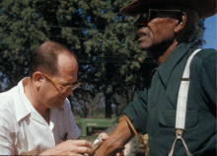
Origins of today’s ethical standards
Nazi experimentation
→ Nuremberg Trials (1945-46)
→ Nuremberg Code (1947)
→ Declaration of Helsinki (1964)
Public Health Service’s Tuskegee Syphilis Study (1932-72)
→ National Research Act
→ The Belmont Report (1978)
Department of Health, Education, and Welfare. Public Health Service. Health Services and Mental Health Administration. Center for Disease Control. Venereal Disease Branch (1970 - 1973)
Notes:
As you are likely familiar, in the 1930s and early 40s, Nazis conducted egregious human experimentation on unwilling subjects, the details of which were discussed in the Nuremberg trials of 1945-46. In response, the research community developed the nuremberg code, which was one of the first major documents on research ethics. It’s first major principle: voluntary consent of participants
Now while the nuremberg trials were going on and the world was rightfully up in arms about ethics abroad, the united states was conducting its own unethical study on the lifespan of untreated syphilis in Black men.
The study was run on African-American men who were only told they were receiving free health care from the United States government. These men were sharecroppers experiencing poverty in Alabama.
Some had syphilis, some did not. The men were told they were receiving free medical care, but in fact they were not receiving any treatment for syphilis.
Study participants were not informed of the true nature of the study nor were they offered treatment when one became available.
•The study included all the hallmarks of unethical principles:
•Deception
•Absence of informed consent
•Of dubious benefit to society, much less the study population
This study was deemed “ethically unjustified” by an advisory panel and led to….

Slide 25
Belmont principles
Respect for persons
Beneficence
Justice

Slide 26
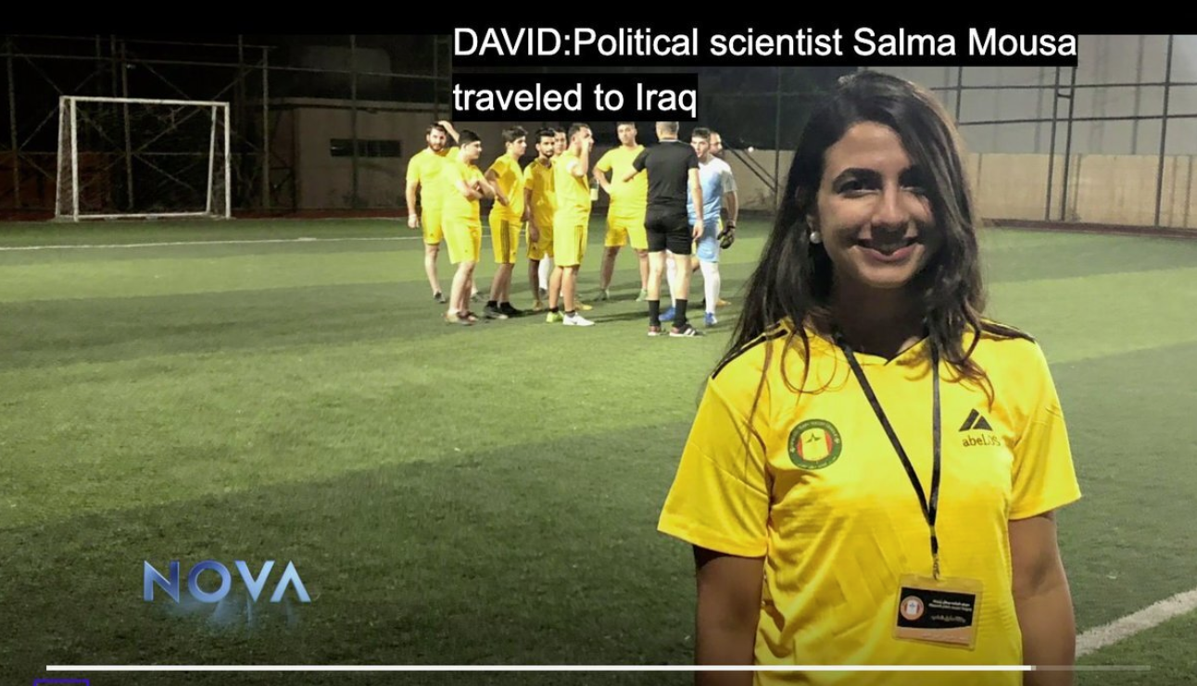
Notes:
To help clarify these principles and demonstrate how they can be applied to a randomized evaluation, we are going to explore a case study. The case study walks through Salma Mousa’s 2017-18 evaluation of Inter-Religious Soccer Leagues on Social Cohesion in Post-ISIS Iraq

Slide 27
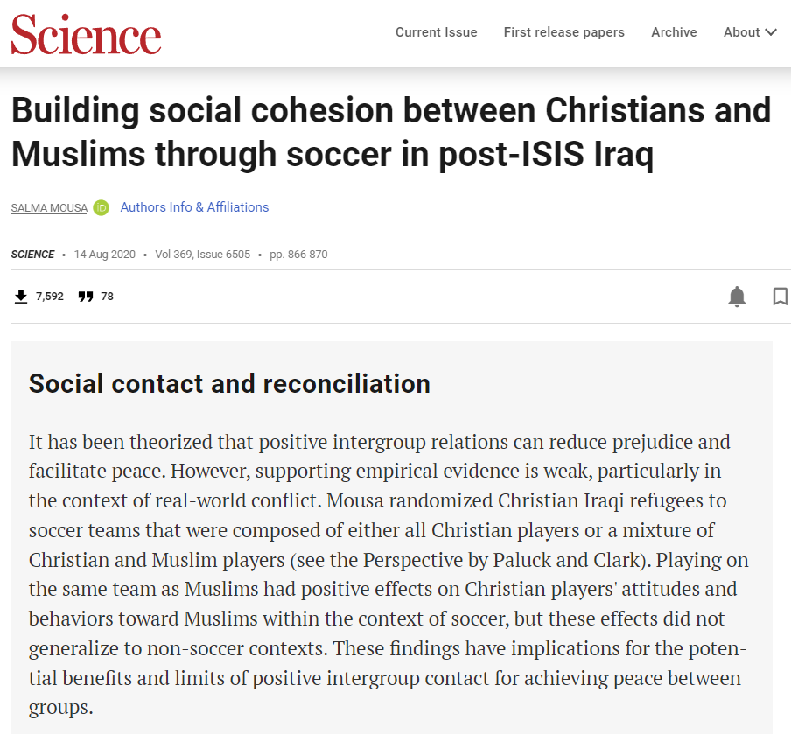
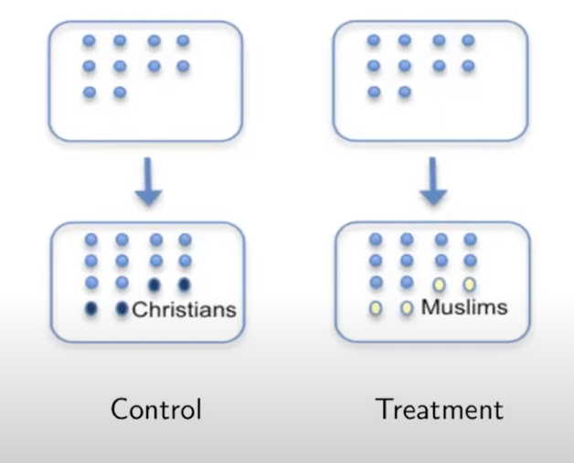
Salma Mousa’s study

Slide 28
Respect for persons
Persons as autonomous agents
Information
Comprehension
Voluntariness
Informed consent

Slide 29
Salma Mousa’s approach to respect
1. Shared details of the study with prospective participants
2. Communicated her aim was connecting Christians and Muslims
3. Captains knew they were receiving three additional players (who may be Muslim)
Participants were invited to make an informed decision on whether to participate
Notes:
Thinking about Mousa’s approach to respect:
REMEMBER “RESPECT” here is treating people as autonomous agents capable of making their own decisions
Mousa employed several approaches in respecting her potential study participants.
She was up front with any and all information about the participant experience, allowing prospective participants to make informed decisions.
During recruitment, she clearly shared the study goals (i.e., build tolerance and community among christians and muslims) and laying out details around the soccer team rosters (i.e., 3 additional players). In doing so, prospective participants knew what to expect and could base their decisions around consenting to participate on this information and their willingness to be in such an environment.

Slide 30
Beneficence
Do good, promote well-being
Do no harm
Minimize risk
Maximize benefits

Slide 31
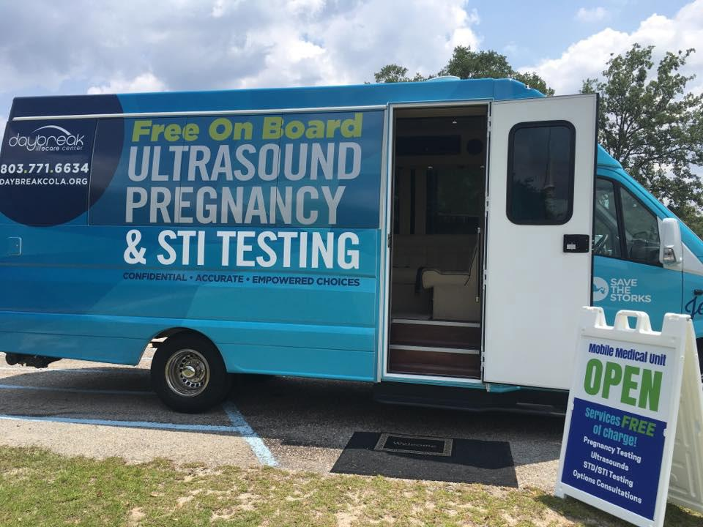
Notes:
Look at this picture… What might you infer about an individual who stepped into or out of this van?
What risk of harm is associated?
People may be at risk of harm—whether psychologically or physically—just because people know they’re associated with a study on a particular topic. For example, if their involvement in a study could reveal something about their sexual activity, sexual orientation, or their HIV status, or that they’re pregnant.
Quick examples:
If you see someone (who isn’t a doctor) coming in or out of this bus, what do you already know about them? Even if their data are “confidential”?
So there are more steps to take here other than just what you.
*image from https://www.daybreakcola.org/mmu/

Slide 32
Salma Mousa’s approach to beneficence
1. Mousa measured harm by collecting data about red cards and other examples of violence on the field
2. Worked to mitigate power differentials among everyone involved in the study, including participants and researchers
3. Ensured local preference drives the intervention
4. Used local community input to inform the intervention
Notes:
REMEMBER “BENEFICENCE” here means “doing no harm” and Minimizing risks.
The study occurs in two locations in Northern Iraq, where ISIS forced Christians and other minorities into exile in 2014. After the fighting, these specific towns were majority Christian, but Muslim from surrounding areas started migrating into predominantly Christian neighborhoods.
Given this, conflict and distrust among Christians and Muslims was high!
Any intervention that intentionally mixes hostile groups in a post-conflict setting could lead to more violence. Mousa took steps to monitor tensions throughout the intervention’s implementation. Essentially, she measure harm and violence through collecting data about red cards (given to players for committing extreme penalties) and other examples of violence on the field. If red cards and instances of violence became concerning, she would have the information and time to alter or stop the intervention.

Slide 33
Justice
“Injustice may appear in the selection of subjects, even if individual subjects are selected fairly by investigators and treated fairly in the course of research. Thus, injustice arises from social, racial, sexual and cultural biases institutionalized in society. [E]ven if individual researchers are treating their research subjects fairly, and even if IRBs are taking care to assure that subjects are selected fairly within a particular institution, unjust social patterns may nevertheless appear in the overall distribution of the burdens and benefits of research. Although individual institutions or investigators may not be able to resolve a problem that is pervasive in their social setting, they can consider distributive justice in selecting research subjects.”
The Belmont Report

Slide 34
Justice
Respect rights and dignity
Fair subject selection and access
Representativeness
Equitable burden & benefit
No exploitation

Slide 35
Salma Mousa’s approach to justice
1. Safeguards and other study design decisions ensured that Christians and Muslims bore the risks equally
2. The larger population beyond town residents, including both Muslims and Christians, stood to benefit from the study
Notes:
REMEMBER “JUSTICE” here is referring to “Fairness in the allocation of risks and benefits”
The study location and sample was selected because the PI had existing relationships with community organizations in those towns (i.e., convenience). This is a poor justification for sample selection, but Mousa and the study team ensured that safeguards were in place and that study design decisions prevented any one group of people from bearing all the risks. In this study neither christians nor muslims exclusively beared the risks.
Despite the convenient sample, the larger population beyond the study towns and their residents, including both Muslims and Christians, stood to benefit from the study. Study findings could benefit interactions between the groups, regardless of which group represented the majority in any one area.

Slide 36
Permits and approvals

Slide 37
Approvers and regulations
Internal Review Boards
Mandatory training
Trial registration
Permission letters
Partnership agreements / MoUs
Legal compliance
Family Educational Rights and Privacy Act (FERPA)
HIPAA
GDPR

Slide 38
IRBs are not enough
Do not cover research staff
Can be side-stepped
Do not decide consistently
Have limited power to enforce regulations

Slide 39

Don’t outsource your ethics!

Slide 40
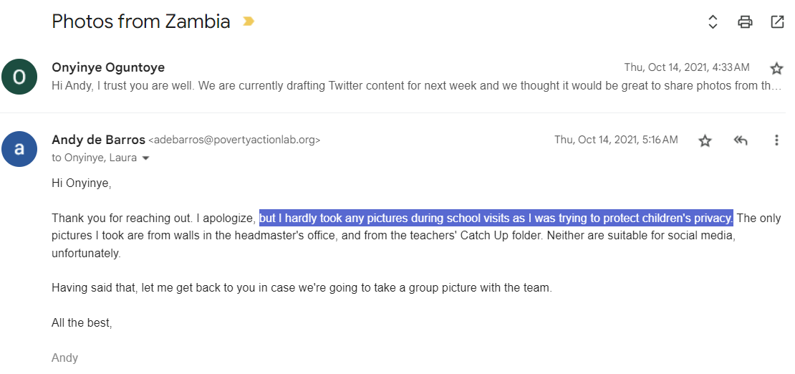
Don’t outsource your ethics!

Slide 41
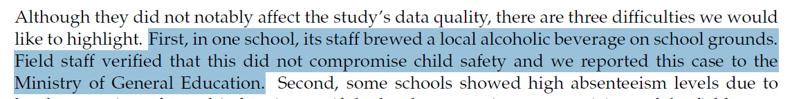
Don’t outsource your ethics!

Slide 42
Final food for thought
Educators experiment on children.
Every day.
They rarely know the result of their experiments.

Slide 43
Plan for next class
“Reading” reactions
Submit on Canvas, ask for help on Slack
Prepare Milestone 2
Due at the end of the week
Meet with your team
Submit on Canvas

